Slide 1
Tvorba webových aplikácií pomocou OOP v PHP s frameworkom Symfony
Ladislav Rado

Slide 2
Koncepty (1)
CRUD – Create, Read, Update, Delete
MVC – Model-View-Controller
REST, JSON, YAML
Dátový model, normalizácia databázy
OOP - trieda, objekt, metóda, atribút, zapuzdrenie, dedičnosť, polymorfizmus, interface, abstraktná trieda
2

Slide 3
Koncepty (2)
Výnimky – try, catch, finally, throw
UML – diagram tried
Dependency Injection, DI Container, autowire
Template engine Twig – extends, include, filter, function
Anotácie v PHP
3

Slide 4
Koncepty (3)
PDO, SQL injection, escape quotes, DQL, QueryBuilder, NativeQuery
ORM Doctrine – findAll, findBy, persist, merge, flush
EntityManager – prepared statements, transakcie (commit, rollback)
Security – CSRF token, CustomAuthenticator
PHPUnit – SUT, assert, mock, stub
4

Slide 5
Projekt – Fakturačný systém
MVC
Model – návrh databázovej schémy, objektový model, ORM
View – šablóny HTML
Controller – REST
Konfigurácia frameworku – .env, .yaml, security, ...
Testovanie – Unit testy, Automatizované akceptačné testy
5

Slide 6
Inštalácia a nastavenie programov pre vývoj webových aplikácií v PHP a MySQL
Apache HTTP Server v2.4.41
PHP v7.4.4
Composer v1.10.1
MariaDB v10.4.12
adminer v4.7.6
xdebug v2.9.4
6

Slide 7
Projekt Faktúry – Návrh dátového modelu
Viacpoužívateľská webová aplikácia
Vytvorenie SQL entít:
Používateľ (user)
Zákazník (customer)
Faktúra (invoice)
Príloha (attachment)
Tovar (article)
Položka na faktúre (invoicearticle)
Vygenerovanie PHP entít pomocou ORM Doctrine + getter&setter
7

Slide 8
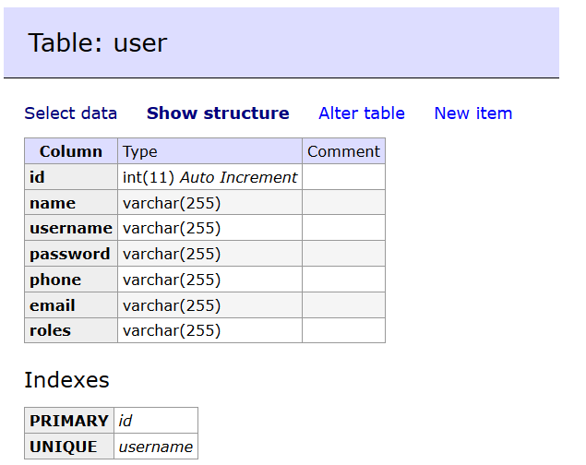
Dátový model – entita Používateľ (user)
CREATE TABLE `user` (
`id` int(11) NOT NULL AUTO_INCREMENT,
`name` varchar(255) NOT NULL,
`username` varchar(255) NOT NULL,
`password` varchar(255) NOT NULL,
`phone` varchar(255) NOT NULL,
`email` varchar(255) NOT NULL,
`roles` varchar(255) NOT NULL,
PRIMARY KEY (`id`),
UNIQUE KEY `username` (`username`)
) ENGINE=InnoDB DEFAULT CHARSET=utf8;
8

Slide 9
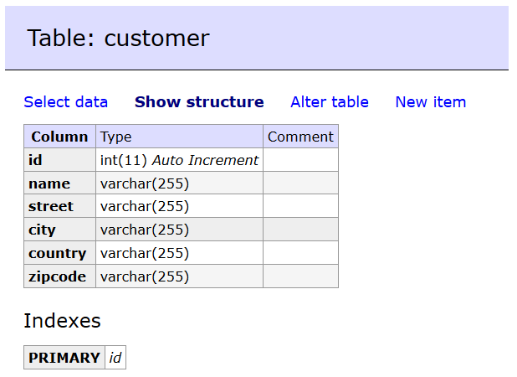
Dátový model – entita Zákazník (customer)
CREATE TABLE `customer` (
`id` int(11) NOT NULL AUTO_INCREMENT,
`name` varchar(255) NOT NULL,
`street` varchar(255) NOT NULL,
`city` varchar(255) NOT NULL,
`country` varchar(255) NOT NULL,
`zipcode` varchar(255) NOT NULL,
PRIMARY KEY (`id`)
) ENGINE=InnoDB DEFAULT CHARSET=utf8;
9

Slide 10
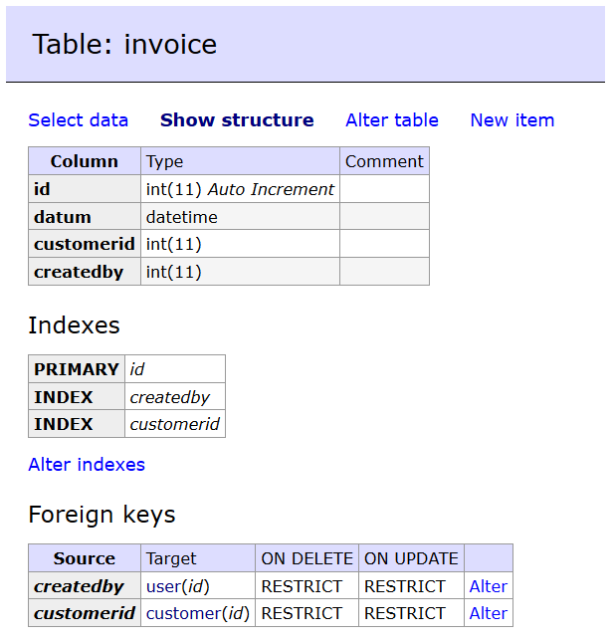
Dátový model – entita Faktúra (invoice)
CREATE TABLE `invoice` (
`id` int(11) NOT NULL AUTO_INCREMENT,
`datum` datetime NOT NULL,
`customerid` int(11) NOT NULL,
`createdby` int(11) NOT NULL,
PRIMARY KEY (`id`),
KEY `createdby` (`createdby`),
KEY `customerid` (`customerid`),
CONSTRAINT `invoice_ibfk_1` FOREIGN KEY (`createdby`) REFERENCES `user` (`id`),
CONSTRAINT `invoice_ibfk_2` FOREIGN KEY (`customerid`) REFERENCES `customer` (`id`)
) ENGINE=InnoDB DEFAULT CHARSET=utf8;
10

Slide 11
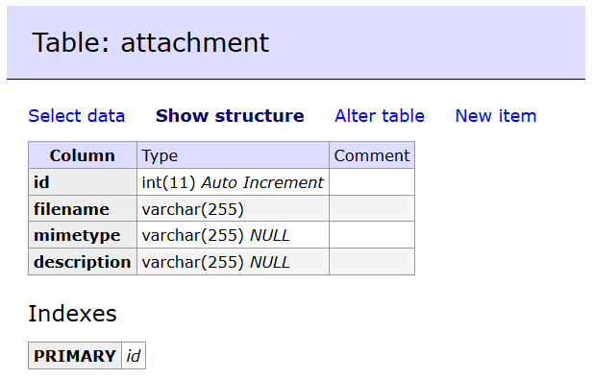
Dátový model – entita Príloha (attachment)
CREATE TABLE `attachment` (
`id` int(11) NOT NULL AUTO_INCREMENT,
`filename` varchar(255) NOT NULL,
`mimetype` varchar(255) DEFAULT NULL,
`description` varchar(255) DEFAULT NULL,
PRIMARY KEY (`id`)
) ENGINE=InnoDB DEFAULT CHARSET=utf8;
11

Slide 12
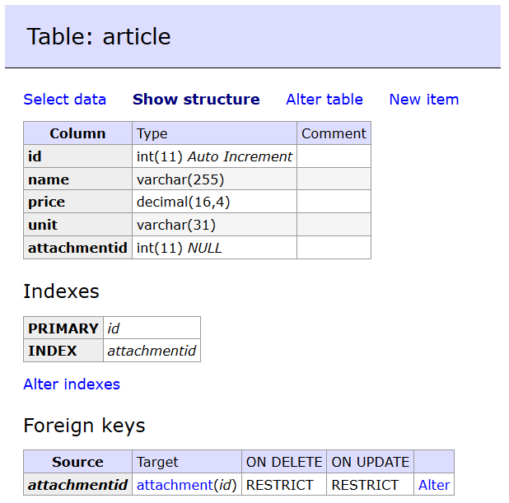
Dátový model – entita Tovar (article)
CREATE TABLE `article` (
`id` int(11) NOT NULL AUTO_INCREMENT,
`name` varchar(255) NOT NULL,
`price` decimal(16,4) NOT NULL,
`unit` varchar(31) NOT NULL,
`attachmentid` int(11) DEFAULT NULL,
PRIMARY KEY (`id`),
KEY `attachmentid` (`attachmentid`),
CONSTRAINT `article_ibfk_1` FOREIGN KEY (`attachmentid`) REFERENCES `attachment` (`id`)
) ENGINE=InnoDB DEFAULT CHARSET=utf8;
12

Slide 13
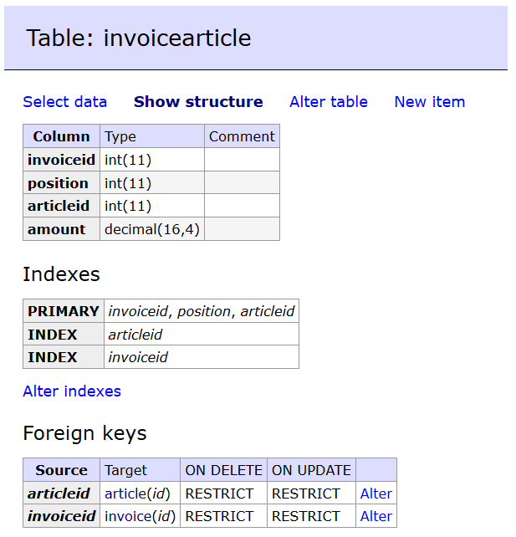
Dátový model – entita Položka na faktúre (invoicearticle)
CREATE TABLE `invoicearticle` (
`invoiceid` int(11) NOT NULL,
`position` int(11) NOT NULL,
`articleid` int(11) NOT NULL,
`amount` decimal(16,4) NOT NULL,
PRIMARY KEY (`invoiceid`,`position`,`articleid`),
KEY `articleid` (`articleid`),
KEY `offerid` (`invoiceid`),
CONSTRAINT `invoicearticle_ibfk_2` FOREIGN KEY (`articleid`) REFERENCES `article` (`id`),
CONSTRAINT `invoicearticle_ibfk_3` FOREIGN KEY (`invoiceid`) REFERENCES `invoice` (`id`)
) ENGINE=InnoDB DEFAULT CHARSET=utf8;
13

Slide 14
Začíname programovať projekt
Požiadavky a rozsah
CRUD – Používatelia, Zákazníci, Tovary, Faktúry, Prílohy
Security – prihlasovací formulár, pridelenie rolí
Generovanie faktúry do PDF
Založenie nového projektu – vygenerovanie kostry
Importovanie knižníc (composer.json) composer update, composer require
Konfigurácia komponentov (.yaml)
Validovať všetok HTML, CSS a JavaScript kód
14

Slide 15
View – Twig template engine (.twig)
{{ variable }} – výpis
{% command %} – príkaz
{# comment #} – komentár
{{ func(arg) }} – funkcia s argumentom
{{ variable|filter }} - filter aplikovaný na premennú
{% block body %} {% endblock %}
{% extends 'base.html.twig' %}
{% include 'combobox_filter.html.twig' with {'combobox': filter_price} %}
{{ path('invoice_edit', {'invoiceid' : invoice.id}) }}
{% if mode == 'edit' %}Editovanie faktúry č. {{ invoice.id }} {% else %}Nová faktúra{% endif %}
{% for user in users %} {% endfor %}
{{ asset('static/jquery.js') }}
{% set some_selected = false %}
15

Slide 16
Formuláre – validácia na strane klienta
Validácia ceny pomocou regulárneho výrazu
<input type="text" name="price[0]" id="price0"
pattern="^(-?[1-9]\d{0,2}([ ]\d{3})*([,.]\d+)?)|
(-?[1-9]\d*([,.]\d+)?)|(-?0[,.]\d+)|0$"
autocomplete="off" inputmode="decimal"
style="text-align:right">

Slide 17
Controller – list
templates/base.html.twig
<nav>
<a href="{{ path('article_list') }}">Zoznam tovarov</a>
</nav>
src/Controller/ArticleController.php
/**
* @Route("/article", name="article_")
*/
class ArticleController extends AbstractController {
/**
* @Route("/list", name="list")
*/
public function showArticleList() {
$articles = $this->articleRepository->findAll();
return $this->render('article_list.html.twig', ['articles'=>$articles]);
}
…
}
templates/article_list.html.twig
{% extends 'base.html.twig' %}
{% for article in articles %}
<tr><td>{{ article.id }}</td>
<td>{{ article.name }}</td>
…
{% endfor %}
17

Slide 18
Controller – add, edit
/**
* @Route("/add", name="add", methods={"GET"})
*/
public function addCustomer(Request $request) {
return $this->render('article_edit.html.twig', ['mode'=>'add', 'article'=>new Article()]);
}
/**
* @Route("/edit/{articleid}", name="edit", methods={"GET"})
*/
public function editCustomer(Request $request) {
$articleid = $request->get('articleid’);
$article = $this->articleRepository->find($articleid);
return $this->render('article_edit.html.twig', ['article'=>$article, 'mode'=>'edit']);
}
18

Slide 19
Controller – add-submit
/**
* @Route("/add/submit", name="add-submit", methods={"POST"})
*/
public function addCustomerSubmit(Request $request) {
$article = new Article();
$article = $this->mapFormToObject($request, $article);
$entityManager = $this->getDoctrine()->getManager();
$entityManager->persist($article);
$entityManager->flush();
return $this->redirectToRoute('article_list');
}
19

Slide 20
Controller – edit-submit
/**
* @Route("/edit/submit/{articleid}", name="edit-submit", methods={"POST"})
*/
public function editCustomerSubmit(Request $request) {
$articleid = $request->get('articleid');
$article = $this->articleRepository->find($articleid);
$article = $this->mapFormToObject($request, $article);
$entityManager = $this->getDoctrine()->getManager();
$entityManager->merge($article);
$entityManager->flush();
return $this->redirectToRoute('article_list');
}
20

Slide 21
metóda mapFormToObject
private function mapFormToObject($request, $article) {
$name = $request->get('article_name');
$price = $request->get('article_price');
$unit = $request->get('article_unit');
$attachmentid = $request->get('article_attachmentid') ?? null;
$attachment = null;
if ($attachmentid != null)
$attachment = $this->attachmentRepository->find($attachmentid);
$article->setName($name);
$article->setPrice($price);
$article->setUnit($unit);
$article->setAttachmentid($attachment);
return $article;
}
21

Slide 22
Validácia formulára User
class UserType extends AbstractType {
public function buildForm(FormBuilderInterface $builder, array $options) {
$builder->add('name', TextType::class, ['label'=>'Name'])
->add('username', TextType::class, ['label'=>'User name'])
->add('email', EmailType::class, ['label'=>'E-mail'])
->add('plainPassword', PasswordType::class, ['label'=>'Password'])
->add('phone', TextType::class, ['label'=>'Telephone'])
->add('locale', ChoiceType::class, ['label' => 'Language',
'choices' => ['Slovensky' => 'sk','English' => 'en']])
->add('roles', ChoiceType::class, ['label' => 'Roles',
'expanded' => true, 'multiple' => true,
'choices' => ['User' => 'ROLE_USER',
'Statistics' => 'ROLE_STAT',
'Admin' => 'ROLE_ADMIN']])
->add('save', SubmitType::class, ['label' => 'Submit']);
}
22

Slide 23
Controller – delete
/**
* @Route("/delete/{articleid}", name="delete")
*/
public function deleteCustomer(Request $request) {
$articleid = $request->get('articleid');
$numDeleted = $this->articleRepository->deleteArticle($articleid);
return $this->redirectToRoute('article_list');
}
23

Slide 24
Controller – attachment_download
/**
* @Route("/download/{attachmentid}", name="download")
*/
public function downloadAttachment(Request $request) {
$attachmentid = $request->get('attachmentid');
$attachment = $this→attachmentRepository->find($attachmentid);
$file = new File(self::$DOCUMENT_DIRECTORY.'/'.$attachment->getFilename());
$response = new BinaryFileResponse($file);
//$response->setContentDisposition(ResponseHeaderBag::DISPOSITION_ATTACHMENT);
$response->headers->set('Content-Type', $attachment->getMimetype());
return $response;
}
24

Slide 25
Controller – attachment_upload
/**
* @Route("/upload", name="upload", methods={"POST"})
*/
public function uploadAttachment(Request $request) {
$file = $request->files->get('uploadedfile');
$attachmentcomment = $request->get('attachmentcomment');
$uploadDir = self::$DOCUMENT_DIRECTORY;
$filename = $file->getClientOriginalName();
$file->move($uploadDir, $filename);
$attachment = new Attachment();
$attachment->setFilename($filename);
$attachment->setMimetype($file->getClientMimeType());
$attachment->setDescription($attachmentcomment);
$this->entityManager->persist($attachment);
$this->entityManager->flush();
return $this->redirectToRoute('attachment_list');
}
25

Slide 26
Controller – login
/**
* @Route("/login", name="login")
*/
public function login(Request $request) {
$username = $request->get('username');
$password = $request->get('password');
$employee = $this->userRepository->queryAuthenticate($username, $password);
if ($employee != null) {
$this->session->set('username', $employee->getUsername());
}
return $this->redirectToRoute('index');
}
26

Slide 27
Controller – logout
/**
* @Route("/logout", name="logout")
*/
public function logout(Request $request) {
$this->session->remove('username');
$this->session->invalidate();
return $this->redirectToRoute('index');
}
27

Slide 28
Controller – JSON autocomplete
/**
* @Route("/autocomplete-article", name="autocomplete-article")
*/
public function jsonAutocompleteArticle(Request $request) {
$term = $request->get('term');
$articles = $this->articleRepository->queryArticleByName($term);
$results = [];
foreach ($articles as $article) {
$results[] = [
'id' => $article->getId(), 'label' = $article->getName(),
'value' = $article->getName(), 'name' => $article->getName(),
'price' => $article->getPrice(), 'unit' => $article->getUnit() ];
}
return new JsonResponse($results);
}
28

Slide 29
Repository - invoice
/**
* @method Invoice|null find($id, $lockMode = null, $lockVersion = null)
* @method Invoice|null findOneBy(array $criteria, array $orderBy = null)
* @method Invoice[] findAll()
* @method Invoice[] findBy(array $criteria, array $orderBy = null, $limit = null, $offset = null)
*/
class InvoiceRepository extends ServiceEntityRepository { public function findRecentInvoices($limit) {
return $this->findBy([], ['datum'=>'DESC'], $limit);
}
public function findByCompany($companyid) {
return $this->findBy(['customerid'=>$companyid], ['datum'=>'DESC']);
}
...
}
29

Slide 30
Repository – QueryBuilder, Paginator
class InvoiceRepository extends ServiceEntityRepository {
public function findRecentInvoicesQueryBuilder($offset, $limit) {
$qb = $this->createQueryBuilder('i');
return $qb->orderBy('i.datum', 'DESC')
->setFirstResult($offset)
->setMaxResults($limit);
}
}
class IndexController extends AbstractController {
/** @Route("/", name="index") */
public function index(Request $request, PaginatorInterface $paginator) {
…
$invoicequerybuilder = $this->entityManager->getRepository(Invoice::class)
->findRecentInvoicesQueryBuilder($offset, $invoicelimit);
$invoices = $paginator->paginate($invoicequerybuilder, $page,$invoicelimit);
return $this->render('index.html.twig', ['invoices' => $invoices]);
}
}
30

Slide 31
Konfigurácia security v YAML (1)
config/packages/security.yaml
security:
encoders:
App\Entity\User:
algorithm: auto
access_control:
- { path: ^/invoice, roles: ROLE_USER }
- { path: ^/customer, roles: ROLE_USER }
- { path: ^/article, roles: ROLE_USER }
- { path: ^/attachment/list, roles: ROLE_USER }
- { path: ^/statistics, roles: ROLE_STAT }
- { path: ^/user, roles: ROLE_ADMIN }
role_hierarchy:
ROLE_ADMIN: ROLE_USER
31

Slide 32
Konfigurácia security v YAML (2)
firewalls:
dev:
pattern: ^/(_(profiler|wdt)|css|images|js)/
security: false
main:
anonymous: lazy
guard:
authenticators:
- App\Security\AppCustomAuthenticator
form_login:
check_path: login
login_path: login
username_parameter: username
password_parameter: password
csrf_parameter: _
logout:
path: logout
target: index
32

Slide 33
Security – CustomAuthenticator
class AppCustomAuthenticator extends AbstractFormLoginAuthenticator {
public function supports(Request $request) { … }
public function getCredentials(Request $request) { … }
public function getUser($credentials, UserProviderInterface $userProvider) { … }
public function checkCredentials($credentials, UserInterface $user) { … }
public function onAuthenticationSuccess(Request $request, TokenInterface $token, $providerKey) { … }
protected function getLoginUrl() { … }
}
33

Slide 34
Testovanie (1)
Unit testy
SUT – System Under Test
beforeClass, afterClass, setup, tearDown
assert
stub, mock
Automatizované akceptačné testy
class IndexControllerTest extends WebTestCase {
private $client = null;
public function setUp() {
$this->client = static::createClient();
}
public function testLogin() { … }
}
34

Slide 35
Testovanie (2)
public function testLogin() {
$crawler = $this->client->request('GET', '/');
$this->assertSame(Response::HTTP_OK, $this->client->getResponse()
->getStatusCode());
$this->assertSame('Prihlásenie', $crawler->filter('h1')->text());
$form = $crawler->selectButton('Prihlásiť sa')->form();
$form['username'] = 'LR';
$form['password'] = 'test';
$crawler = $this->client->submit($form);
$this->assertTrue($this->client->getResponse()->isRedirect('/'));
$crawler = $this->client->followRedirect();
$this->assertSame('Používateľ: LR', $crawler->filter('nav span')->text());
$this->assertSame('Posledne pridané faktúry', $crawler->filter('h1')->text());
}
35

Slide 36
Záver
Možnosti rozšírenia:
Validácia formulárov ✓
Stránkovanie (pagination) ✓
CSRF token ✓
Optimistic locking
Verzie entít
36

